Slide 1
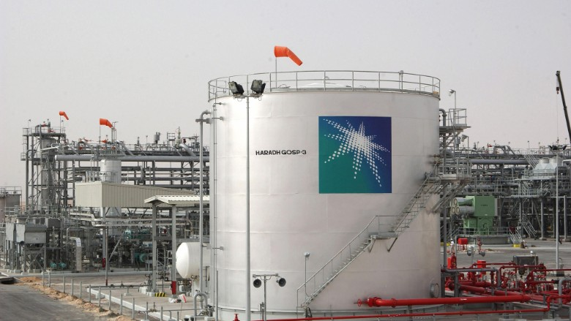
Cyber Attack on Saudi Aramco 2012
CSL2450
Glen TEAKLE 10532981
Semester 1 2022
Figure 1
Saudi Aramco Oil Company

Slide 2
One of the world’s largest oil companies, Saudi Aramco was subject to a cyber breach on August 15, 2012.
A group calling themselves the “Cutting Sword of Justice” claimed responsibility, as an apparent retaliation for “widespread crimes against humanity”.
Malware was installed on Aramco’s network after an email containing a malicious file was opened by an employee.
The Malware, dubbed “Shamoon”, activated itself on a specific date, at a specific time.
When activated (via a dropper) it began wiping files and Master Boot Records (MBR’s) of around 35,000 computers, rendering Aramco’s systems unusable.
85% of Aramco’s infrastructure was either disabled or unbootable.
Aramco was unable to sell oil to domestic gas trucks for 17 days.
OVERVIEW OF ATTACK
It took up to 5 months for Aramco to be back to normal operations.
(Council on Foreign Relations, 2012).
(Constantin, 2012).
(Mackenzie, 2012).
(Pagliery, 2015).
(Rhysider, 2019).
(Schwartz, 2012).
(Science Direct, 2012).

Slide 3

April/May 2012 – Malware sent through email
Email opened, malicious link clicked and malware installed
August 15, 2012, 11:08AM (Saudi Arabia time) - Malware (logic bomb) activated through built in timer.
Computers begin shutting down, files are erased
Entire network temporarily disabled
85% of infrastructure taken out
Oil sales are ceased and eventually oil was given to companies for free
New computers bought to replace infected ones
5 months later: Aramco back online with expanded Cyber Security team and new secure network
(Constantin, 2012).
(Mackenzie, 2012).
(Pagliery, 2015).
(Rhysider, 2019).
(Schwartz, 2012).

Slide 4

CONSEQUENCES OF THE ATTACK
Temporary disabling of Aramco networks
No internet, forced to use “old school” communication methods (typewriters, faxes)
Domestic sale of oil ceased
Oil given away for free
Up to 35,000 computers affected; 85% of Aramco’s infrastructure disabled
Computers disabled for a week and ultimately needing replacing
World supplies of HDD’s were limited/unavailable as Aramco bought 50,000 to replace infected ones
Subsequently, the price of HDD’s increased temporarily
(Mackenzie, 2012).
(Pagliery, 2015).
(Science Direct, 2012).

Slide 5

Phishing - A scam email containing the malware was opened by an untrained staff member (computer technician)
Shamoon was installed into the network
People are the weakest link in an organisation (Social engineering)
Attack planned during the holiday of Ramadan with minimal staff in Aramco offices
Aramco’s “flat network” was exploited
Employees had little to no security training
Computers were likely not patched with the latest updates; old versions of programs with known vulnerabilities also a possible target
Seemingly no antivirus checks on downloaded material i.e. files, whether automatic or manually done
How the attack occurred/
VULNERABILITIES EXPLOITED
(Council on Foreign Relations, 2012).
(Constantin, 2012).
(Mackenzie, 2012).
(Pagliery, 2015).
(Rhysider, 2019).
(Schwartz, 2012).

Slide 6
Computer screens flickering
Files being erased/overwritten
Data destroyed and computers wiped to some extent
Computers being shutdown
Master boot record overwritten, making the computers unable to reboot
Many backup servers erased
Supply of oil to numerous companies was halted
Aramco out of action for around 3 months
Staff wary about using computers again
Reputational damage/trust in Aramco
AFFECTS OF THE MALWARE
(Council on Foreign Relations, 2012).
(Constantin, 2012).
(Pagliery, 2015).
(Rhysider, 2019).

Slide 7
EXPLOITED WEAKNESSES
PEOPLE
Staff with no security training/awareness
Opening files without scanning for viruses first
Staff with no restriction access for opening email attachments (Principle of least privilege)
Minimal staff operation on day of attack (Ramadan holiday)
PROCESS
No spam filtering on systems
No auto scan of file attachments in emails once opened
No contingency plan/Disaster Recovery Plan

Slide 8
RECOMMENDATIONS
PEOPLE
Staff training (emails)
PROCESS
Principle of least privilege
No unauthorised downloads
Regular (daily) scans for malware/intrusion
Backups offsite (cloud or other)
Contingency plan/DRP
TECHNOLOGY
Patch updates regularly and automatically where possible
Use latest software where possible
(ACSC, 2022).

Slide 9
REFERENCES
Australian Cyber Security Centre. (2022). Information security manual. ACSC. https://www.cyber.gov.au/sites/default/files/2022-03/Information%20Security%20Manual%20%28March%202022%29.pdf
Council on Foreign Relations, (2012). Compromise of Saudi Aramco and RasGas. Council on Foreign Relations. https://www.cfr.org/cyber-operations/compromise-saudi-aramco-and-rasgas
Constantin, L. (2012, August 23). Kill timer found in Shamoon malware suggests possible connection to Saudi Aramco attack. Computerworld. https://www.computerworld.com/article/2491501/kill-timer-found-in-shamoon-malware-suggests-possible-connection-to-saudi-ar.html
Mackenzie, H. (2012, October 25). Shamoon Malware and SCADA Security – What are the impacts? Tofino Security. https://www.tofinosecurity.com/blog/shamoon-malware-and-scada-security-%E2%80%93-what-are-impacts
Network Security, (2012). Middle east oil firms hit by massive attack. Network Security. 2012(9), 2-19. https://www-sciencedirect-com.ezproxy.ecu.edu.au/science/article/pii/S1353485812700788
Pagliery, J. (2015, August 5). The inside story of the biggest hack in history. CNN Business. https://money.cnn.com/2015/08/05/technology/aramco-hack/
Rhysider J. (Host). (2019, January 22). Shamoon. (Episode 30). [Audio Podcast Transcript]. Darknet Diaries. https://darknetdiaries.com/transcript/30/
Schwartz, M. (2012). Saudi Aramco Restores Network After Shamoon Malware Attack. Informationweek – Online. https://www.proquest.com/trade-journals/saudi-aramco-restores-network-after-shamoon/docview/1035205264/se-2?accountid=10675

